Slide 1
Physiology of Muscle II
Dr. D T D Warnakulasuriya
Department of Physiology

Slide 2
Summary of Muscle physiology I
The functional anatomy of the skeletal muscle
Neuromuscular Junction transmission (NMJ)
Factors interfering with NMJ transmission

Slide 3
Disorders of skeletal muscles
Examples:
Myasthenia gravis
Muscular dystrophies
Myopathies

Slide 4
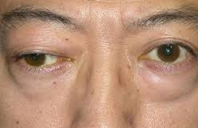
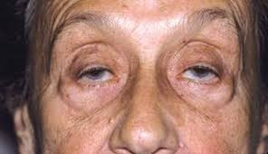
Myasthenia gravis
Chronic autoimmune neuromuscular disease
Affect voluntary muscle
Meaning ‘Grave muscle weakness’
Symptoms
Eyes
Drooping of one or both eyelids (ptosis).
Double vision (diplopia), which may be horizontal or vertical, and improves or resolves when one eye is closed.

Slide 5
Symptoms cont.
Face
Altered speaking
Difficulty swallowing
Problems chewing
Limited facial expressions
Weakness of muscles that worsen with activity,
Arms
Legs
Neck

Slide 6
Investigations
Edrophonium test (Tensilon test)
Repeated movement or ask the patient to focus at a point above their field of vision- wait for muscle to weaken
Small dose of IV Edrophonium chloride (short acting Ach esterase inhibitor)
Look for improvement of symptoms
Serum antibody (anti-AChR) level

Slide 7
Treatment
Acetylcholine esterase inhibitor (Neostigmine, Pyridostigmine)
Immunosuppressive agents (eg. Steroids)
IV Immunoglobulin
Plasmapheresis
Surgery
Thymectomy

Slide 8
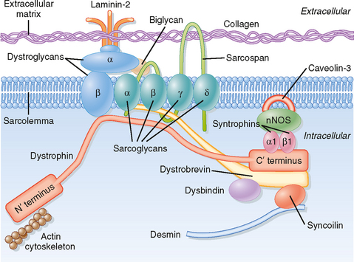
Muscular dystrophies
Progressive weakness of skeletal muscles
Mild-severe-fatal
Muscular dystrophies are caused by multiple causes.
Congenital defects in the dystrophin gene is one of the main causes
Other causes
Sarcoglycans and other components of Dystrophin-glycoprotein complex
Titin
Desmin
Dystrophin-glycoprotein complex provides structural support to muscle

Slide 9
Heritable MDs include the following:
Sex-linked MDs - Duchenne, Becker
Autosomal dominant MDs - Facioscapulohumeral, distal, ocular, oculopharyngeal
Autosomal Recessive MD – Limb-girdle form

Slide 10
Muscular Dystrophies
Duchenne muscular dystrophy
No dystrophin protein in muscle
Fatal by the age of 30
Becker muscular dystrophy
Dystrophin is present in reduced in amount or altered

Slide 11
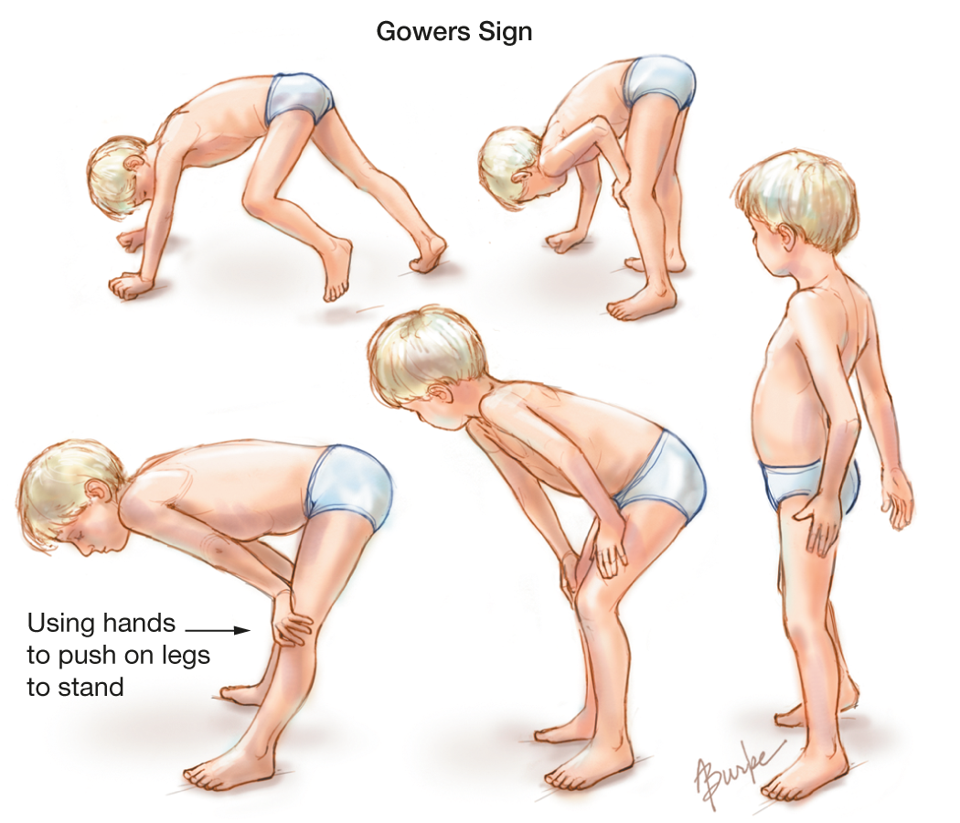
Gowers Sign

Slide 12

Duchenne timeline

Slide 13
Metabolic Myopathies
Mutations in genes coding for enzymes involved in muscle metabolism
Exercise intolerance is a key feature
Eg: McArdle syndrome
Other causes of myopathies
Inherited myopathies - Muscular dystrophies
Endocrine myopathies - excess steroids, hyper/hypothyroidism, hyperparathyroidism
Inflammatory myopathies - Polymyositis, Dermatomyositis
Toxic myopathies - Alcohol excess and drugs

Slide 14
OBJECTIVES At the end of the lecture students should be able to
Compare and contrast fast and slow twitch muscle fibers
Define the terms
Summation, twitch contraction, tetanic contraction and clonus
State the changes in skeletal muscle during exercise
Isotonic contraction
Isometric contraction

Slide 15
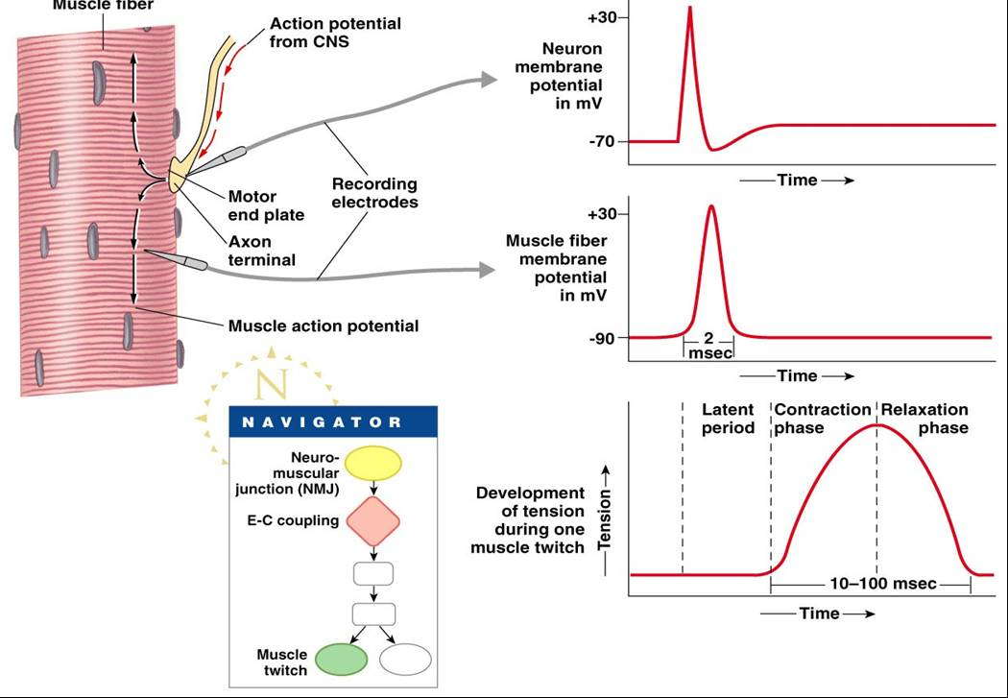
Electrical activity of skeletal muscle
Similar to nerve
Depolarization is by Na+ influx
Repolarization is by K+ efflux
No plateau phase

Slide 16
Muscle fiber
RMP -90 mV
Action potential lasts 2 - 4 ms
Velocity of conduction along the muscle fiber 5m/s
Absolute refractory period 1 - 3 ms long
After polarizations are prolonged
Contractile mechanism has no refractory period

Slide 17
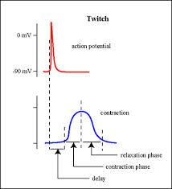
MUSCLE TWITCH
With a single action potential the skeletal muscle show a brief contraction followed by relaxation
Twitch starts 2 ms after the start of depolarization
Duration of a twitch vary with the type of muscle

Slide 18
TYPE OF MUSCLE ACCORDING TO DURATION OF TWITCH
FAST FIBERS
Short twitch duration
Muscles with type II B fibers
Large fiber diameter
Extensive SR for rapid release of Ca2+
Glycolytic capacity high
Less blood supply and few mitochondria
Also called WHITE MUSCLES
For fine skilled movements
Eg: Extra-ocular muscles
SLOW FIBERS
Long twitch duration
Muscles with type I fibers
Smaller fiber diameter
Smaller nerve fiber innervation
Glycolytic capacity low
Extensive blood supply, many mitochondria and myoglobin
Also called RED MUSCLES
For long, slow, posture maintaining movements
Eg: Muscles of the legs and back

Slide 19
Classification of fiber types in skeletal muscles
 | Type 1 | Type IIA | Type IIB
Other names | Slow oxidative | Fast oxidative glycolytic | Fast Glycolytic
Color | RED | RED | WHITE
Myosin ATPase activity | Slow | Fast | Fast
Ca2+ pumping by SR | Moderate | High | High
Diameter | Small | Large | Large
Glycolytic capacity | Moderate | High | High
Oxidative capacity | High | Moderate | Low
Myoglobin content | High | High | low
Speed of contraction | Slow | Fast | Fast
Activities best suited for | Endurance- Running a marathon | Sprinting Walking | Short term intense

Slide 20
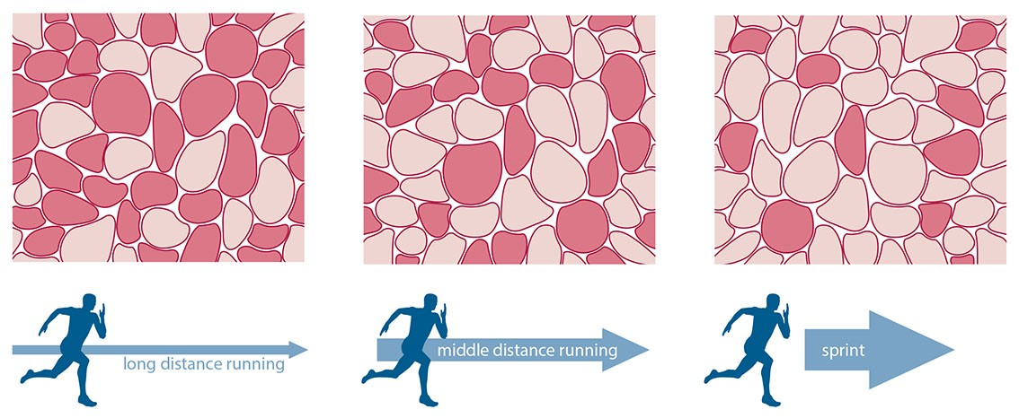
Muscle fiber type in exercise

Slide 21
Summation of contraction
Adding of individual twitch contractions increase the intensity of contraction
FREQUENCY SUMMATION: increase frequency of AP, 2nd contraction occur before completion of the 1st
MULTIPLE FIBER SUMMATION: increasing the number of motor units in response to a stronger stimulus.

Slide 22
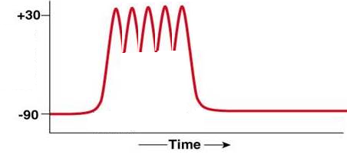
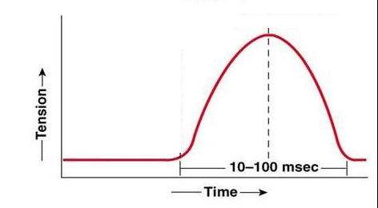
FREQUENCY SUMMATION:

Slide 23
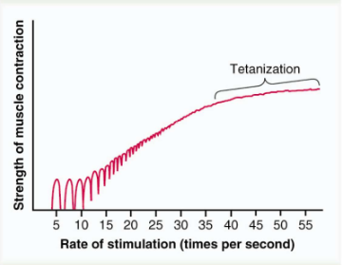
Tetanization
Repeated rapid stimulation of the skeletal muscle where the frequency reach a critical level that contractions fuse together
Complete tetanus : If muscle sarcoplasm has a continuous supply of Ca²⁺ then the contraction is sustained. No relaxation in between.

Slide 24
Clonus
Repetitive sequential contraction of flexors and extensors
Tone
Toughness of muscle at rest
Low rate of nerve impulses from the spinal cord

Slide 25
Question
Which of the Following are true regarding skeletal muscles?
Action potentials are mainly due to Ca²⁺ ions.
The twitch starts with the start of the action potential.
The contractile mechanism has a refractory period.
Tetanus is a form of multiple fiber summation.
Muscle tone is due to low rate of impulses from the spinal cord.
FFFFT

Slide 26
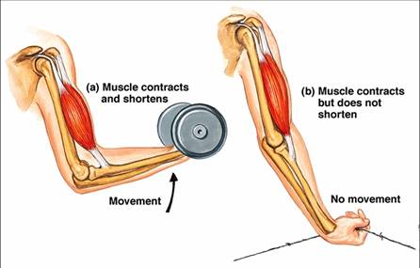
TYPES OF MUSCLE CONTRACTION

Slide 27
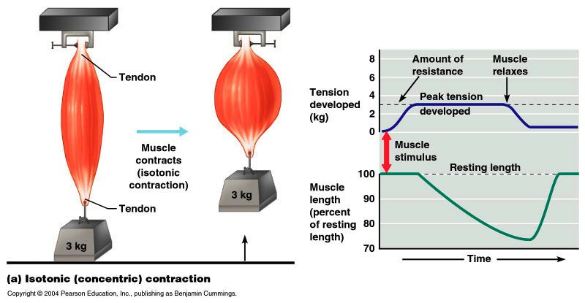
TYPES OF MUSCLE CONTRACTION
Isotonic contraction:
Muscle length shortens
Tone / load remains the same
Work ( Force x Distance) done

Slide 28
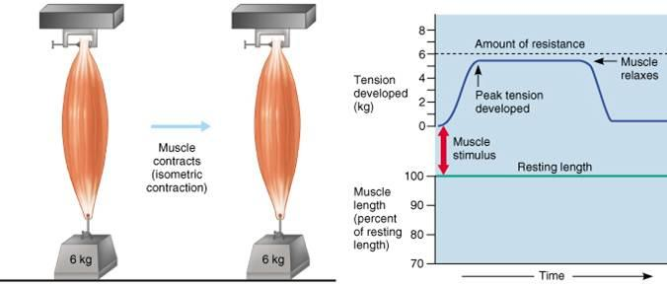
TYPES OF MUSCLE CONTRACTION
Isometric contraction
Muscle length remains same (elastic and viscous elements)
Muscle tension increases
Work is not done

Slide 29
How does Succinylcholine cause muscle paralysis?
Mimic Ach but not broken down by Ach esterase
Continued opening of cation channel
Cause persistent depolarization
Ach can not elicit a response by binding to the receptor
Ca²⁺ is removed from the sarcoplasm independent of the above process so muscles become relaxed
Persistent depolarization leads to desensitization
Used in general anesthesia for skeletal muscle relaxation in surgery or mechanical ventilation.

Slide 30
SUMMARY
Disorders of skeletal muscles
Electrical events in a skeletal muscle
Fast twitch fibers Vs Slow twitch fibers
Summation
Tetanization
Clonus
Tone
Difference between Isotonic and isometric contraction

Slide 31
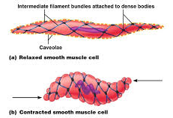
Smooth muscle contraction
Lack cross striations
Actin and myosin filaments are present and slide on each other to produce contraction.
Dense bodies instead of Z lines.
Actin filament is composed of actin and tropomyosin molecules.

Slide 32
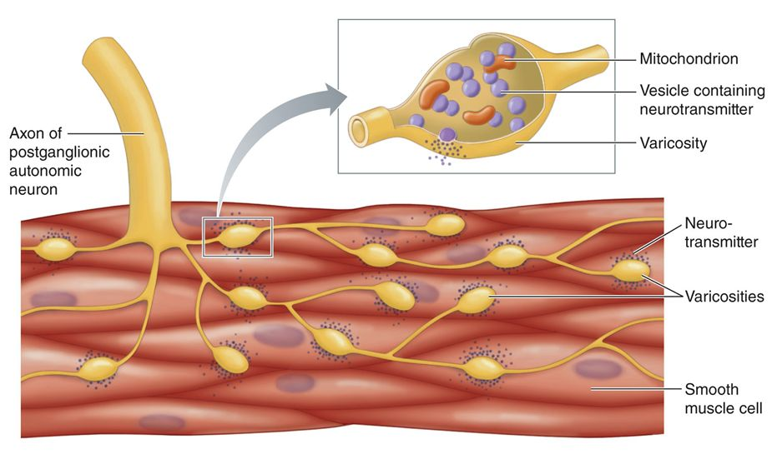

Slide 33
Types of smooth muscles
1. Multiunit smooth muscles
2. visceral smooth muscles

Slide 34
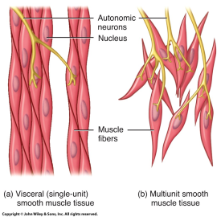
Multi unit smooth muscles
Responsible for finely graded movements Eg: Iris
Not voluntary
Consist of separate motor units innervated separately
AP does not spread from a fiber to another
No spontaneous contractions

Slide 35
Visceral smooth muscle – a single motor unit
Responsible for sustained chronic contractions.
Eg: Viscera ( intestine, uterus, bladder)
AP travel from one cell to the other via gap junctions
Can contract spontaneously

Slide 36
Smooth muscle contraction is stimulated by
Nerve impulses
Hormonal and paracrine agents
Stretch of muscle
Chemicals
Drugs
Pacemaker cells

Slide 37
Increase in intramuscular Ca²⁺ is by
Release from extracellular stores
Voltage gated channels
Ligand gated channels
Release from intracellular stores
Ryanodine receptors (RyR)
Inositol triphosphate receptors (IP₃R)

Slide 38
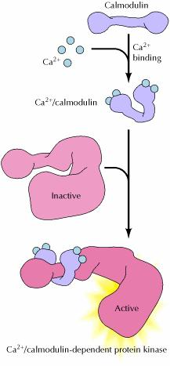
Molecular basis of smooth muscle contraction
Ach bind to muscarinic receptors
Increase Ca²⁺ influx to cell
Activate calmodulin-dependent myosin light chain kinase

Slide 39
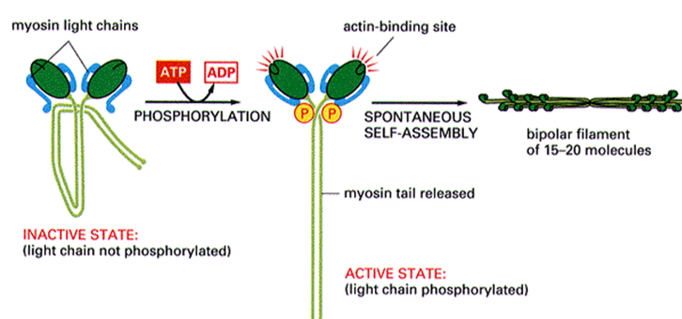
Molecular basis of Smooth Muscle contraction
Phosphorylation of myosin
Increased myosin ATPase activity
Binding myosin to actin
Contraction

Slide 40
Relaxation of Smooth Muscle
Reduced Ca²⁺ concentration stops myosin kinase activity
Myosin light chain phosphatase, dephosphorylates myosin
Relaxation
Sustained contraction due to latch bridge mechanisms makes the smooth muscles use less energy

Slide 41
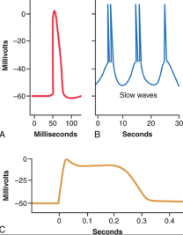
Electrical activity of a smooth muscle
smooth muscle spike potential
Repetitive spike potentials elicited by slow rhythmical electrical waves
Action potentials with a plateau
Voltage gated Na⁺ channels are less in number
The action potentials are mainly caused by voltage gated Ca²⁺ channels.
Ca²⁺ ions directly act on smooth muscle contractile mechanisms.

Slide 42
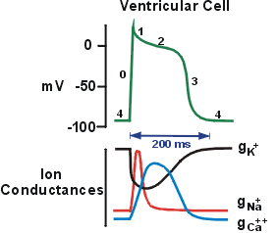
Cardiac muscle contraction
Striations similar to skeletal muscles but the muscle fibers branch.
Intercalated discs and gap juctions between the fibers.
T system at Z lines.
RMP is -80mv
AP has a plateau phase
influx of extracellular Ca²⁺ increase ER Ca²⁺ release.
Absolute refractory period last up to half of phase 3 so tetanization is not seen.

Slide 43
Question
Which of the Following are true?
Smooth muscle cells have a longer action potentials than nerves.
Multi unit smooth muscles contract with out an action potential being generated
Actions potentials can be generated in unitary smooth muscles spontaneously.
Smooth muscle contraction is dependent on extracellular fluid Ca²⁺concentration.
The skeletal muscle SERCA pumps are fast acting compared to those removing Ca²⁺ in smooth muscle.
TTTTT

